Slide 1
Instructional Leadership The Foundation for a Professional Learning Community
Case Study: Athy Education Campus

Slide 2
Athy Education Campus
Athy College
Athy Model Scoil
Scoil
Phadraig
Naofa
Gaelscoil Átha Í

Slide 4
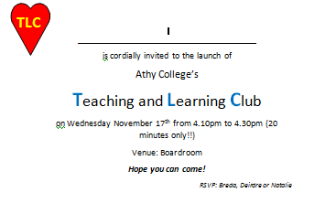
Notes:
Cascading IL – the invitation issued to all staff to our first TLC meeting

Slide 8
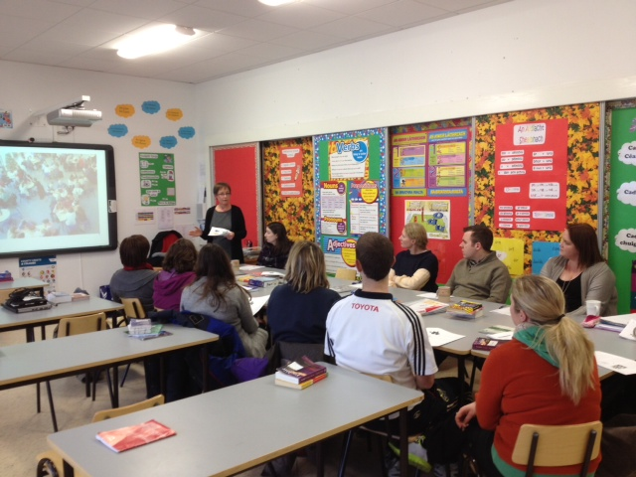

Slide 10
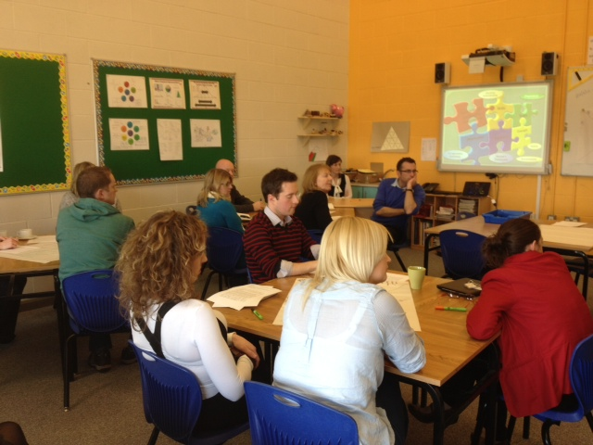

Slide 11
